Slide 1
1.6.8.7 Division of complex numbers

Slide 2
Introduction
In this topic, we will
Define the division of one complex number by another
Derive this from multiplication and multiplicative inverses
Look at a geometric interpretation
Observe some properties

Slide 3
The multiplicative inverse
Recall that given , we have that

Slide 4
Complex division
The division of a complex number by another may be written as
You can always leave this as but we will calculate the entire expression explicitly

Slide 5
Complex conjugate approach
We will use the final form to quickly find the formula:
For example, to calculate , we have

Slide 6
Polar representation approach
Now, if and ,
For example, to calculate , we have

Slide 7
Complex division
Let’s check that

Slide 8
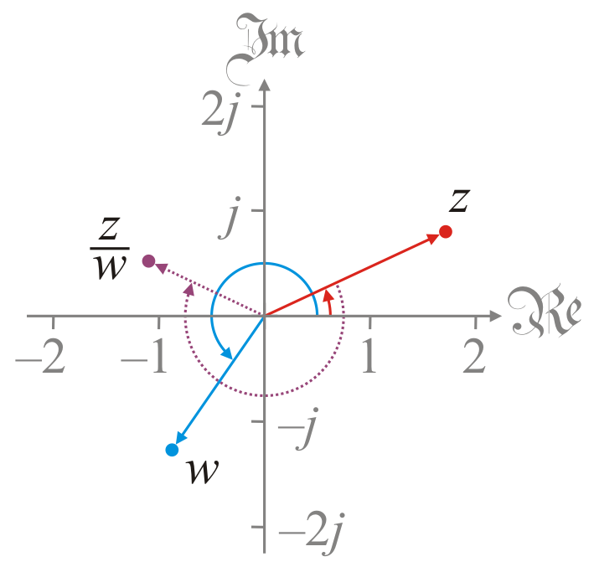
Geometric interpretation
The geometric interpretation of a ratio is
The ratio of the magnitudes
The angle of the dividend minus the angle of the divisor

Slide 9
Properties
Theorem:
Proof:
QED

Slide 10
Properties
Theorem:
Proof: If and ,
Thus,
QED

Slide 11
Properties
For example,

Slide 12
Summary
In this topic, we’ve introduced division of complex numbers
We used two approaches
Complex conjugates and polar representation
We saw the geometric interpretation:
The ratio of the magnitude
A difference of the angles
We saw a number of properties

Slide 13
References
[1] https://en.wikipedia.org/wiki/Complex_number#Reciprocal_and_division

Slide 14
Acknowledgments
None so far.

Slide 15
Colophon
These slides were prepared using the Cambria typeface. Mathematical equations use Times New Roman, and source code is presented using Consolas.
The photographs of flowers and a monarch butter appearing on the title slide and accenting the top of each other slide were taken at the Royal Botanical Gardens in October of 2017 by Douglas Wilhelm Harder. Please see
https://www.rbg.ca/
for more information.

Slide 16
Disclaimer
These slides are provided for the ne 112 Linear algebra for nanotechnology engineering course taught at the University of Waterloo. The material in it reflects the authors’ best judgment in light of the information available to them at the time of preparation. Any reliance on these course slides by any party for any other purpose are the responsibility of such parties. The authors accept no responsibility for damages, if any, suffered by any party as a result of decisions made or actions based on these course slides for any other purpose than that for which it was intended.

